Slide 1
Data Science Final report Telecom Churn
學生 : 林奕勳

Slide 2
Task
Introduction data
Data Visualization
Imbalance Data
Feature Engineering
Normalize
Model Training/Prediction
Logistic regression , DNN

Slide 3
Introduction data
Target Variable
Telecom Churn Datasets
Feature(19筆)
State , Account length , Area code , International plan , Voice mail plan , Number vmail messages , Total day minutes , Total day calls , Total day charge , Total eve minutes , Total eve calls , Total eve charge , Total night minutes , Total night calls , Total night charge , Total intl minutes , Total intl calls , Total intl charge , Customer service calls
總共 : 2666 筆 資料

Slide 4
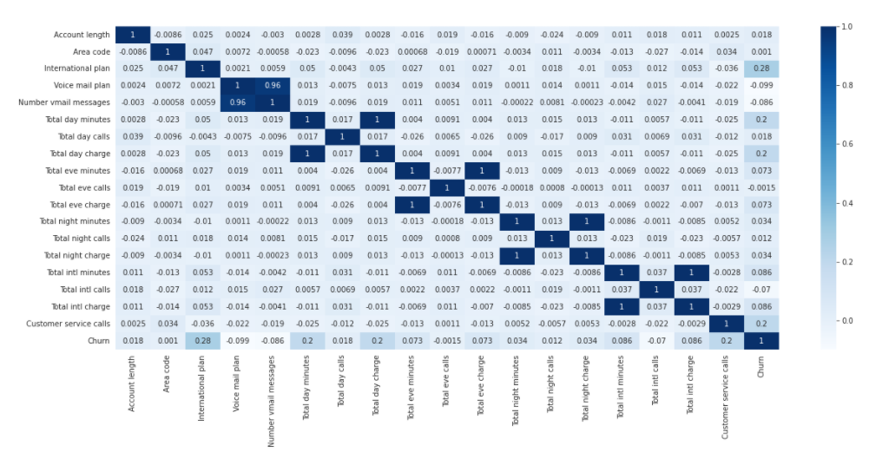
Plot the heatmap to check the correlation

Slide 5
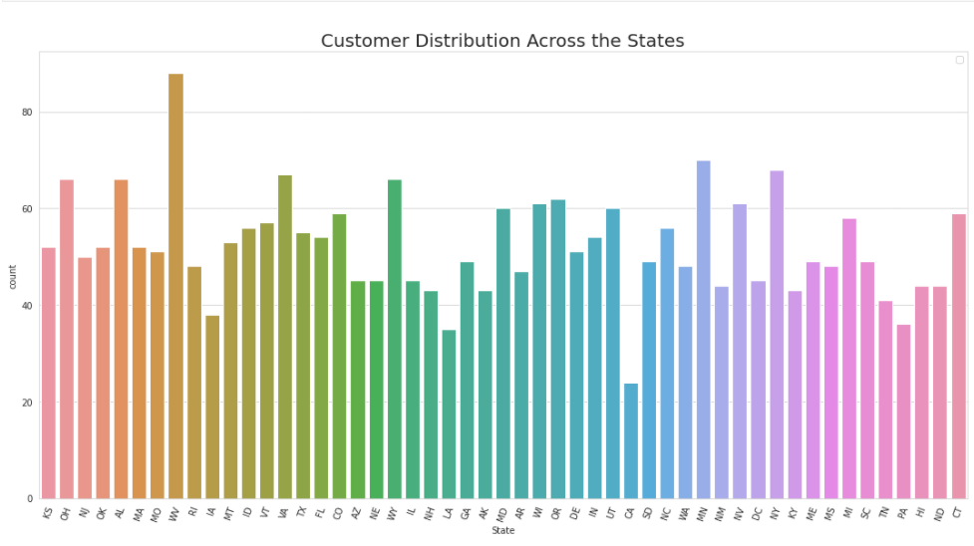
check the customer and churn distribution across the states

Slide 6
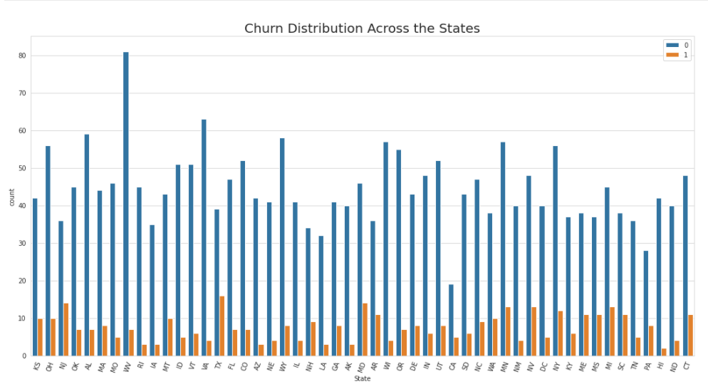
Imbalance Data

Slide 7
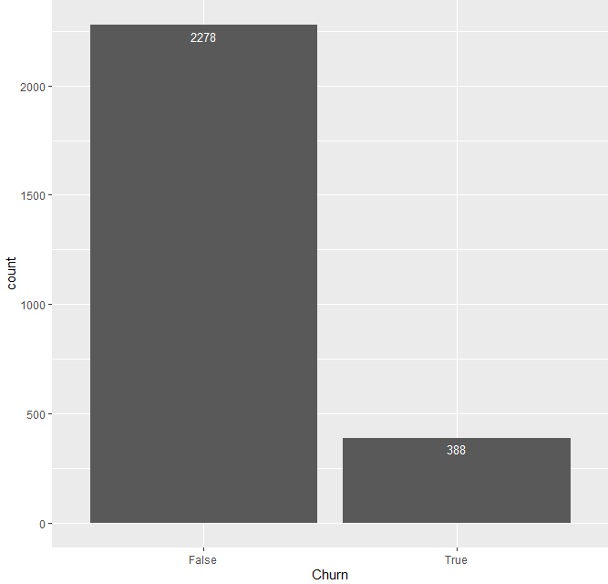
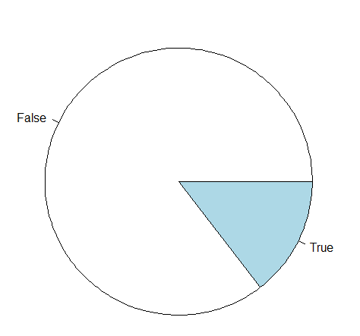
Imbalance Data

Slide 8
Feature Engineering
create three new features Total minutes, Total calls and Total charge
Total calls = Total day calls + Total eve calls + Total night calls + Total intl calls
Total minutes = Total day minutes + Total eve minutes + Total night minutes + Total intl minutes
Total charge = Total day charge + Total eve charge + Total night charge + Total intl charge

Slide 9
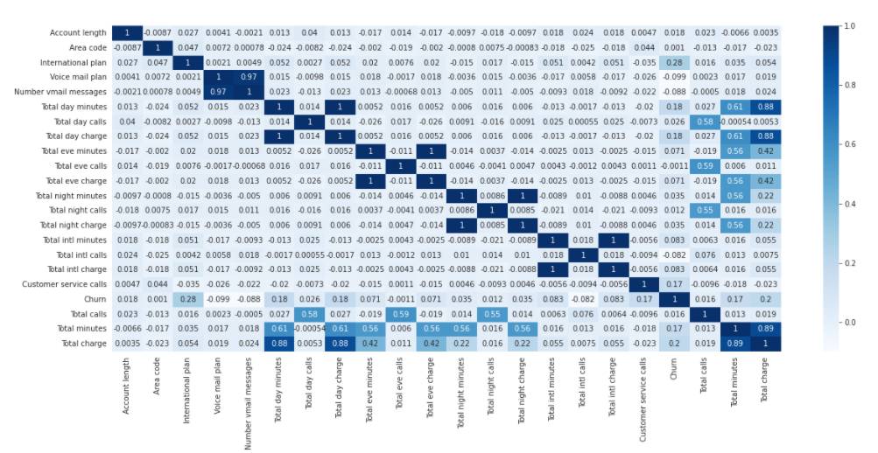
Plot the heatmap to check the correlation
check for the highly correlated original variables , and normalize

Slide 10
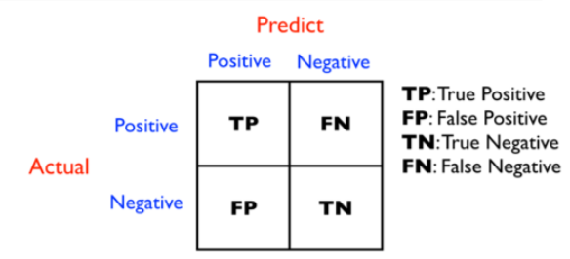
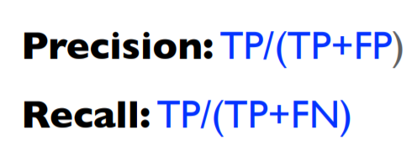
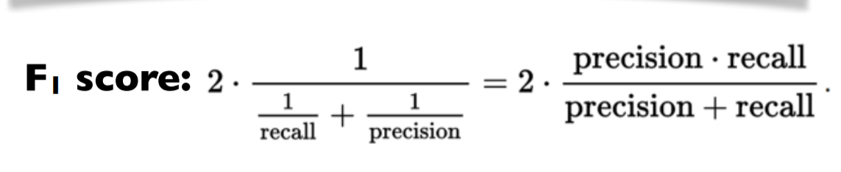
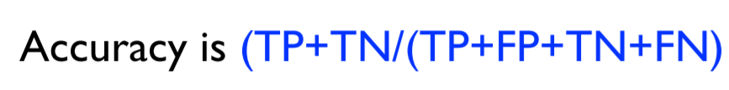
Confusion Matrix

Slide 11
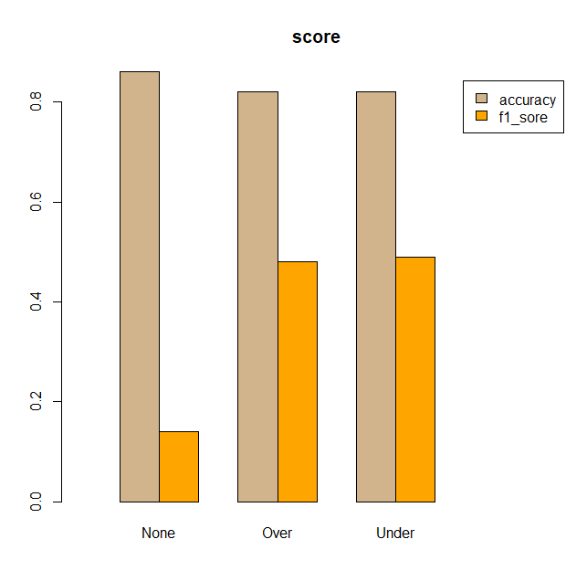
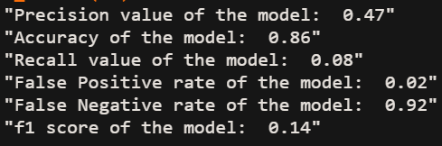
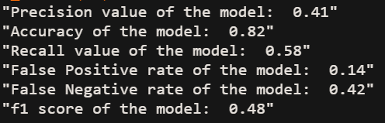
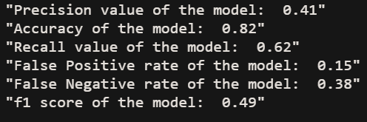
Model (logistic regression)
None
Oversampling
Undersample

Slide 12
Down-sampling
對多數的那⼀⽅抽樣，形成50%-50%之⽐例
優點：簡單且計算成本會⼤幅降低
缺點：因為抽樣的關係，所以模型 variance 會⽐較⼤，也就是每次抽樣 所學習之模型，差異性會⽐較⼤。
Over-sampling
對少數那⼀⽅重複抽樣，形成50%-50%之⽐例
優點：相對於 down-sampling，模型的 variance 會⽐較低
缺點：因為增加資料量的關係，計算成本會⼤幅增加。
Apply different weights on the penalty term
策略上為為給於不同類別不同的權重
優點：不需要增加訓練資料量
缺點：需要修改演算法

Slide 13
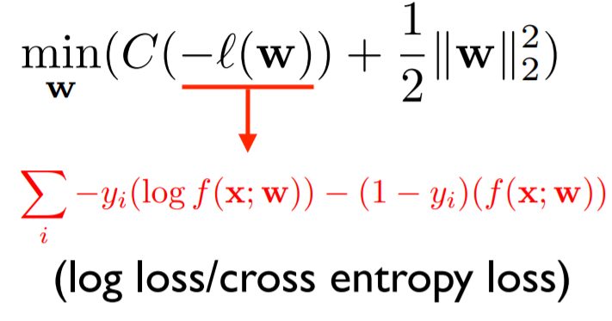
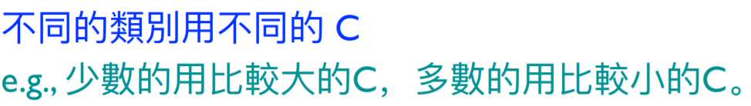
Apply different weights on the penalty term

Slide 14
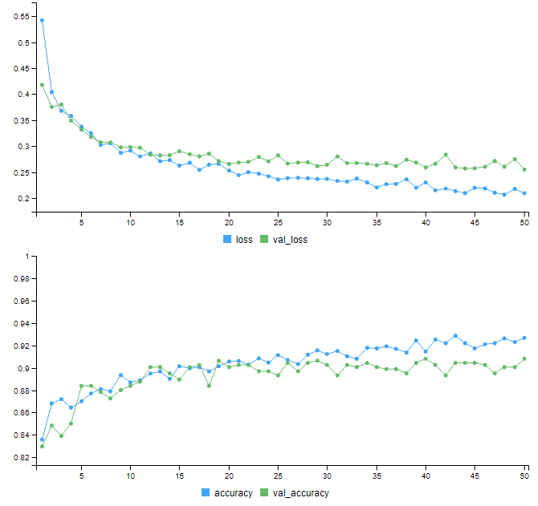
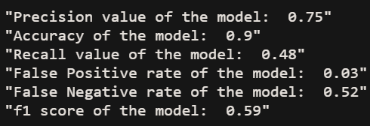
deep learning model without class weights (DNN) on Label encoding
Loss : cross entropy
Optimizer : SGD
Epochs : 50
Hidden layer : 4

Slide 15
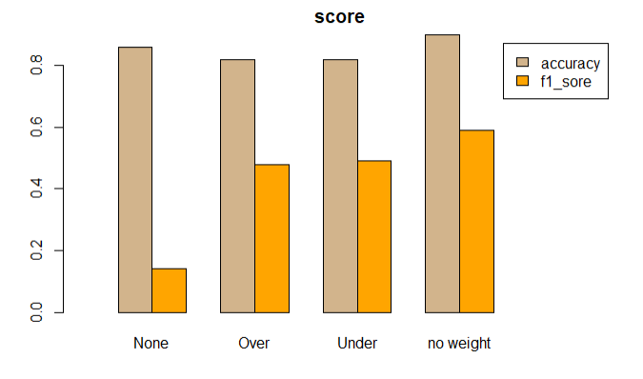
deep learning model without class weights (DNN) on Label encoding

Slide 16
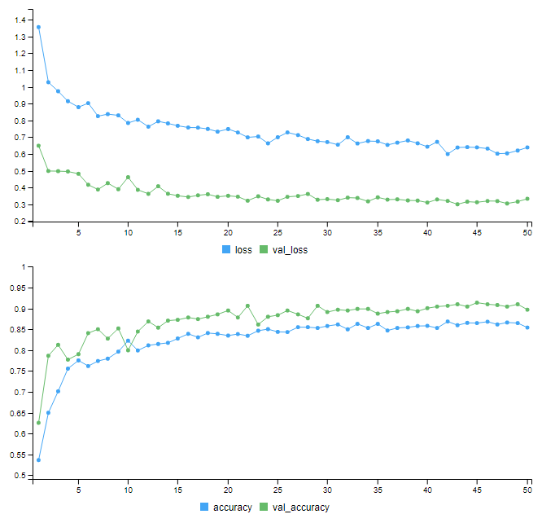
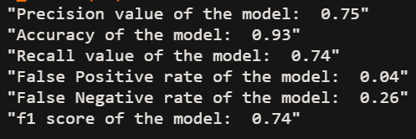
deep learning model with class weights (DNN) on Label encoding
with class weights
(“Ture”= 2278/388 , “False”=1)
Loss : cross entropy
Optimizer : SGD
Epochs : 50
Hidden layer : 4

Slide 17
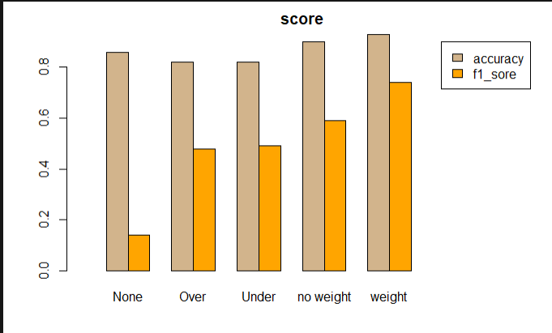
Conclusion

Slide 18
Thanks for your attending

